Slide 1
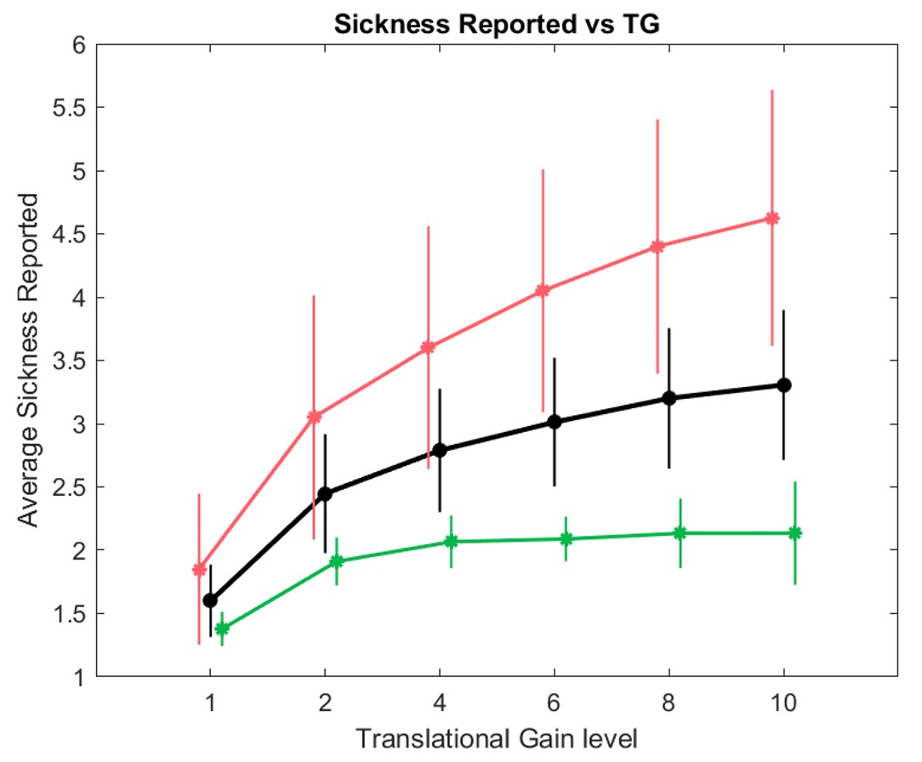
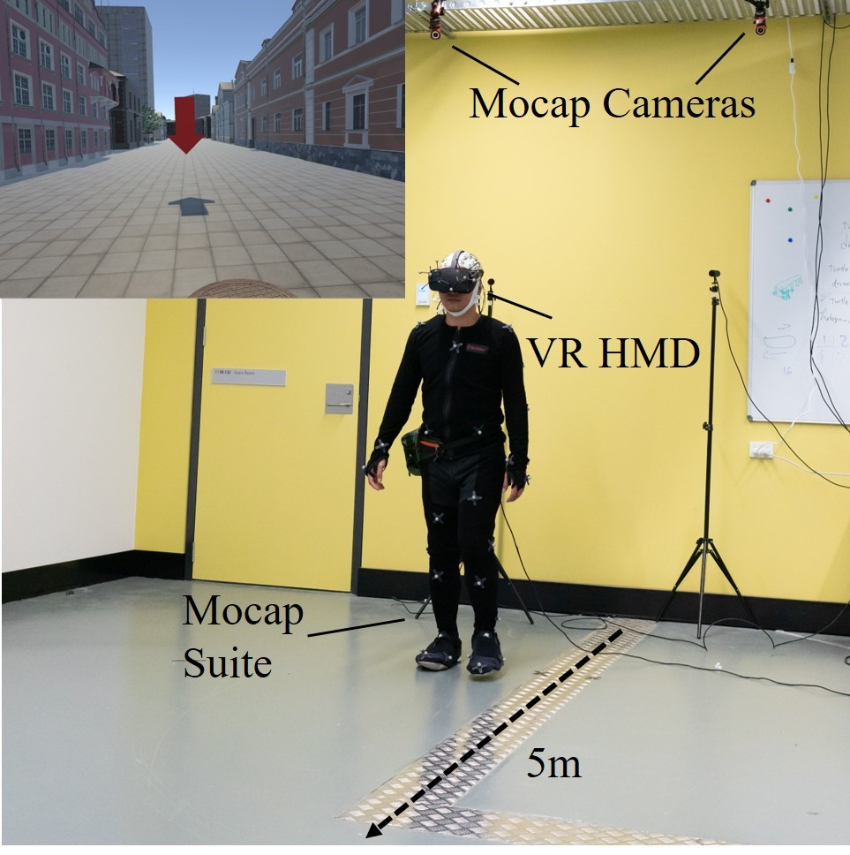
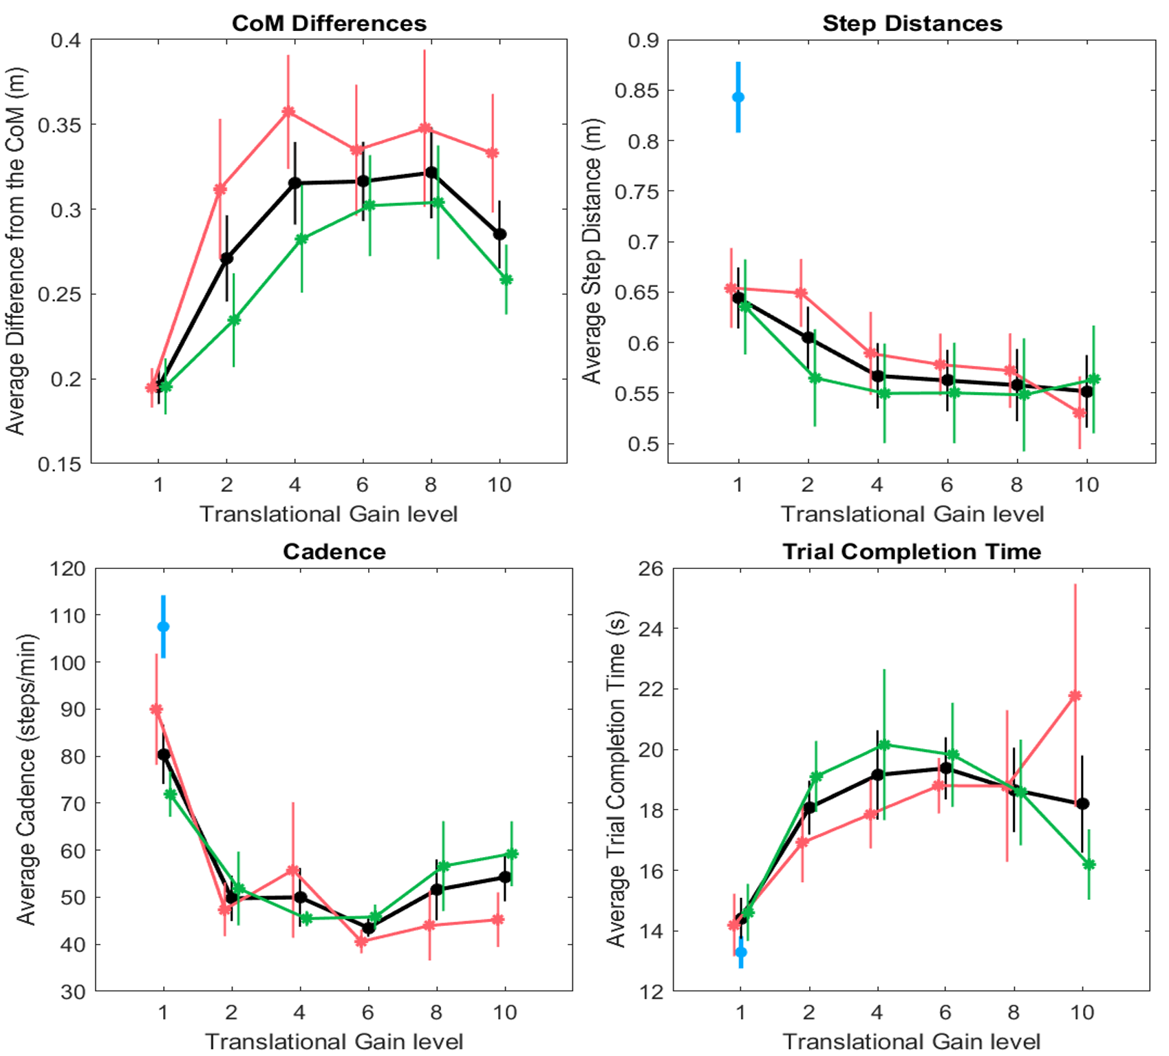
Effect of Non-Isometric Virtual Walking on VR Sickness
Carlos Alfredo Tirado Cortes
UTS CIBCI
Carlos.TiradoCorts@uts.edu.au
Introduction
Results
Translational Gain (TG) is a type of Non-Isometric virtual walking that changes the gain value of virtual walking (i.e. for every step the participant in real life uses, he/she will give 2, 4, 6, etc.). We tested on 17 participants how different levels of TG affect their level of sickness, and how that level of sickness can be measured by the participant’s body kinematics.
Simulator Sickness Results
A Simulator Sickness Questionnaire was applied during and after the experiment to quantify the levels of sickness of the participant. The in-experiment questionnaire help us to measure the evolution of sickness during the experiment. The post-experiment questionnaire helped us to group the participants into two groups (based on their results): Motion Sick participants (red lines), and No-Motion Sick participants (green lines). Black lines represent data from both groups combined.
Figure 2: Level of Sickness vs Translational Gain
Kinematics Results
Before the experiment started, a set of baseline trials were recorded to compare against (marked in blue). The 4 kinematic values measured are difference in Center of Mass (the difference between the location of the CoM at baseline vs CoM at different TG levels), step distance, cadence, and trial completion time. Data was also divided between MS participants (green line) and No-MS participants (red line).Note how at the end No-MS participants tend to overall adapt to the TG levels, while the MS participants tend to perform worse as the levels of TG increase.
Figure 1: Experiment setup for non-isometric walking.
References
Figure 3: Different measurements vs level of TG.
O. Janeh, G. Bruder, F. Steinicke, A. Gulberti, and M. Poetter-Nerger. Analyses of Gait Parameters of Younger and Older Adults during (Non-
)Isometric Virtual Walking. IEEE Transactions on Visualization and Computer Graphics, 24(10):2663–2674, 2018. doi: 10.1109/TVCG.
2017.2771520
R. S. Kennedy, N. E. Lane, K. S. Berbaum, and M. G. Lilienthal. Simulator sickness questionnaire: An enhanced method for quantifying simulator sickness. The International Journal of Aviation Psychology, 3(3):203–220, 1993. doi: 10.1207/s15327108ijap0303
Conclusions
Most participants could accomplish the non-isometric virtual walking, even with large gains and without any prior training. However, overall, as the TG increased, participants reported higher VR sickness scores during the experiment.

